Slide 1
Using video surveillance to
better the airport service
Chen xxx 151xxx94G
Chen xxx 151xxx43G
Liu xxx 151xxx74G
Yang xxx 1511xxx46G

Slide 2
Introduction
New features
Techniques
CONTENTS
Performance evaluation

Slide 3

Background
The airport VIP service
Tertiary industry
Limitation of techniques
What is airport vip?
.
.
Investment and return
Survey = 6%*total
Feasibility

Slide 4

Business Value
Direct revenue
Brand building
More business chance

Slide 5
Motivation
Economic
Security
Convenience

Slide 6
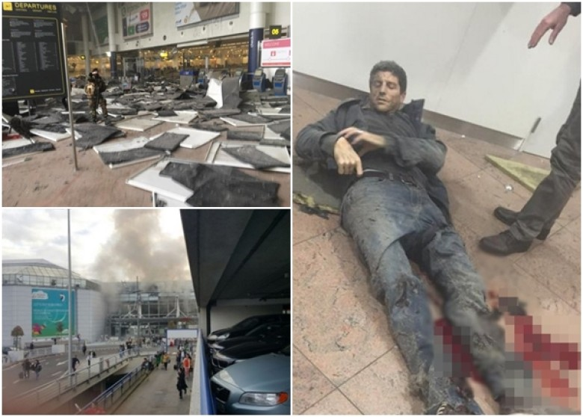
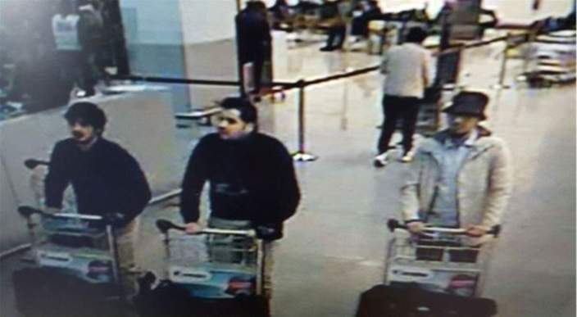
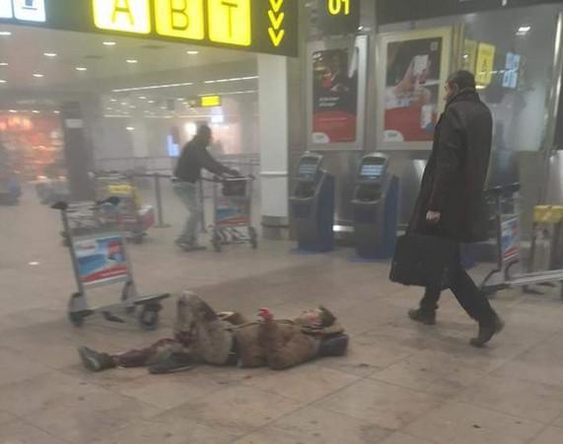
Why Security
Warning: Following Pictures may be disturbing to some viewers. Viewer discretion is advised.
警告：以下图片可能会引起部分观众不适。请谨慎观看。

Slide 7
Why Security
Security reason
Easy Target
Return of reputation

Slide 8
Security Solutions
Detect unidentified people who enter the VIP lounge, and alert the airport staff.
Detect
abnormal objects occurred near the VIP lounge, and alert the airport staff.
Two new features

Slide 9


Techniques-VIP recognition
Face Sampling
and
Face Detecting
Feature Extrature
（PCA）
Face Recognition
(SVM)
Sampling the frames from video
and detecting faces of passengers
Extractiing PCA features of the test images
Recognizing VIP passengers according to SVM.
34x34
VIP Passengers Recognition and Security Checking

Slide 10
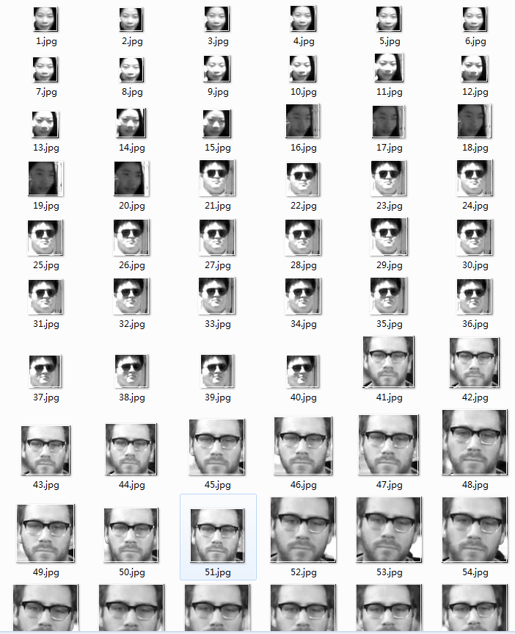



Face Training Sets

Slide 11


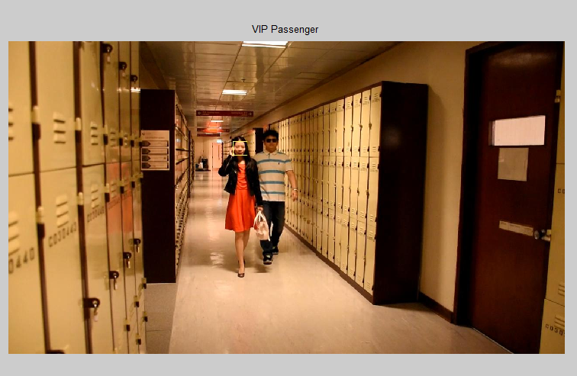
Test Sets

Slide 12
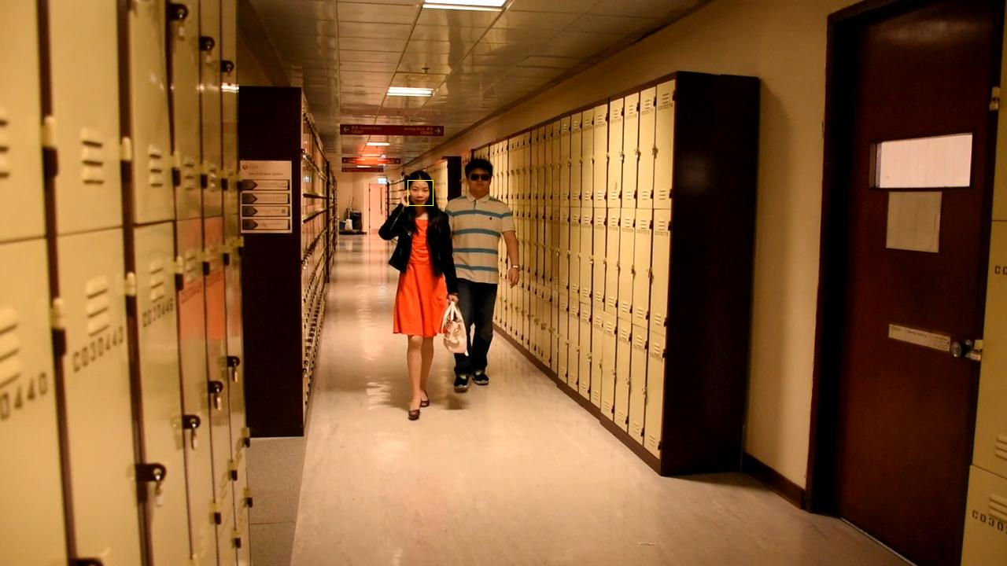

Slide 13
Techniques-Abnormal objects
Background Image Calculation
Counting residence time of abnormal objects
Foreground Object Extraction
Calculating the background image
If time > threshold(1minute)
Alert !
Recognitzing abnormal objects
VIP Passengers Recognition and Security Checking

Slide 14
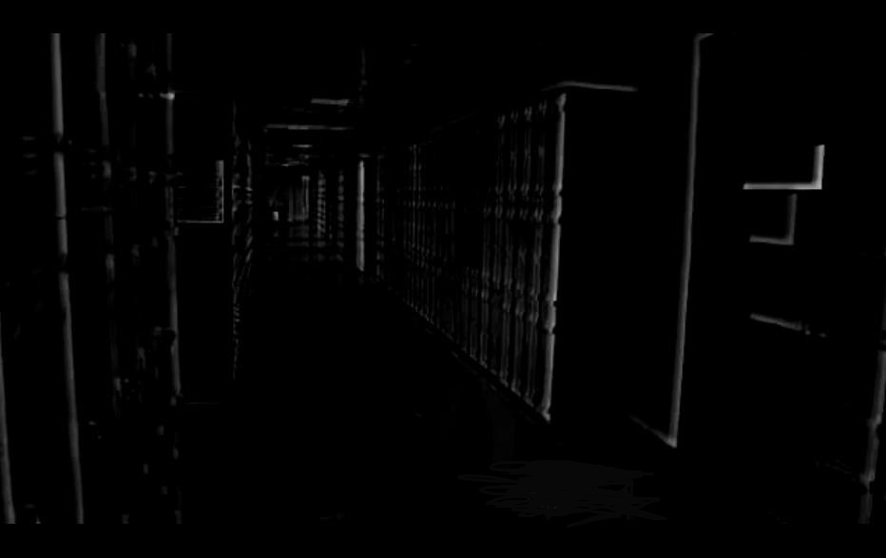
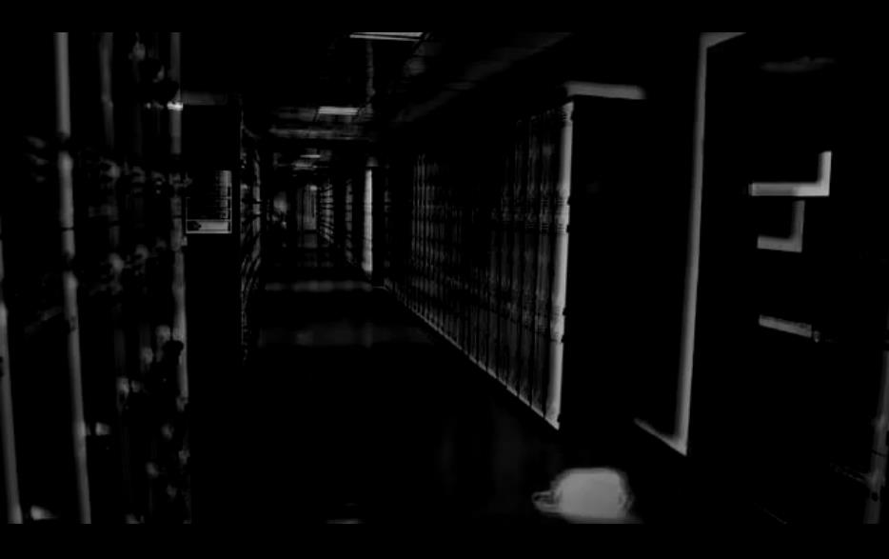
Abnormal Objects Recognition
Background
Foreground

Slide 15
Performance Evaluation
1 recognition rate
2 customer satisfaction index
Flow of passengers
Flow of VIP
3 return on investment
Multi camera networks
Cameras Resolution

Slide 16
Thank you
Q&A

